Slide 1

Green University of Bangladesh
Department of Computer Science & Engineering
Presented By
Supervisor:
MS. Fatema Tuj Johora
Lecturer
Department Of CSE
Green University Of Bangladesh
Shuvobroto Biswas (183002066)
MD. Arobi Emon (183002057)
Susmita Rani (191002139)

Slide 2
Outline
Introduction
Motivation
Objectives
Problem Statement
Related work
Requirements
Methods And Approaches
Proposed System
Use Case Diagram
DFD Diagram
Tools
Limitations
Testing
References

Slide 3
Introduction
Our Social media app is a cross platform software which helps us to find many thing in one app.
Simple and easy to use platform that makes quick finding.
Users can solve their problems through chat.
Users satisfaction and useful features are our main goal.

Slide 4
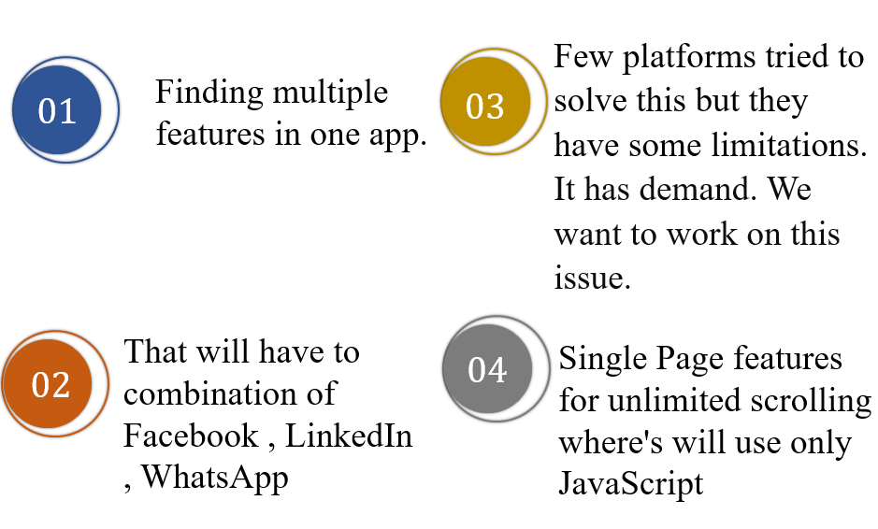
Motivation

Slide 5
Objectives
Prioritizes user privacy and data protection.
Promotes responsible information sharing and discourages fake news and disinformation.
Encourages healthy social connections and discourages addictive design patterns.
Enables users to create and share content easily and intuitively.
Facilitates real-time communication between users.

Slide 6
Problem Statement
THE ISSUES
THE RESOLUTIONS
THE OUTCOMES

Slide 7
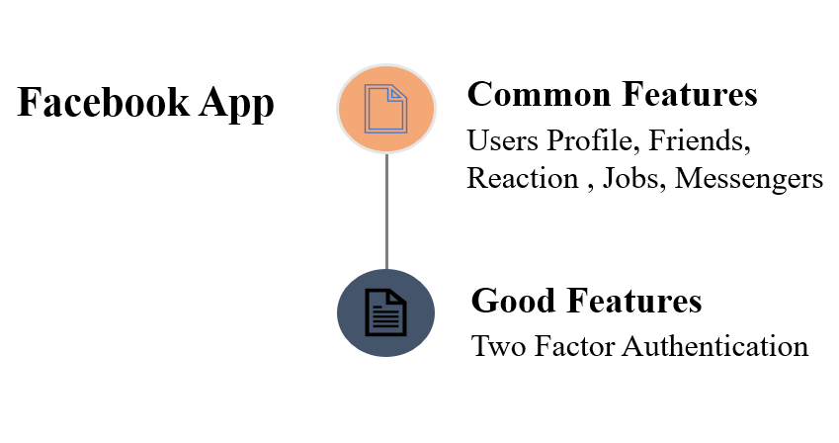
Related Work

Slide 8
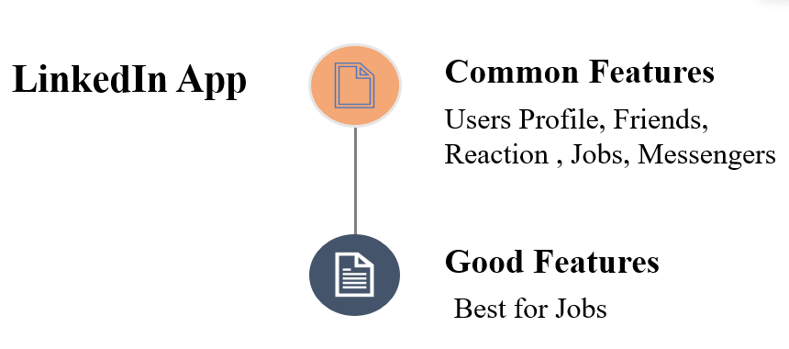
Related Work

Slide 9
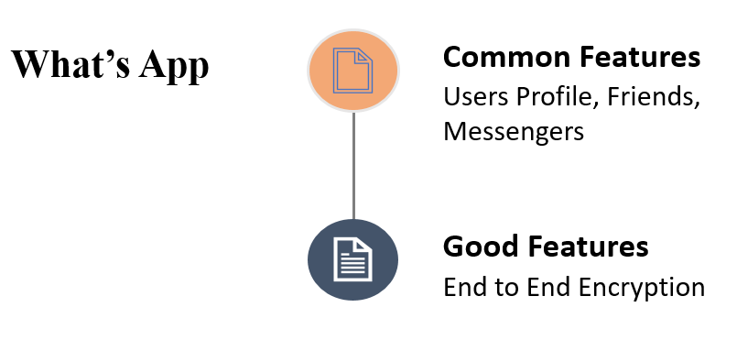
Related Work

Slide 10
Requirements
Functional Requirements | Non-Functional Requirements | User Requirements
Home Page User List Job Board Profile Settings | Performance Usability Security Portability Helpline | Easy and simple to operate Quick response Effectively Handling Operational Errors User Support

Slide 11
Methods And Approaches
Setup Environment
Database
Ready SDK
Integrate APIS
Opening Dev Server
Ready to Build PS
Customizing Codes
Publish to Stores
Make UI

Slide 12
Proposed System
Proposed Systems:
Our software will provide some unique features along with emergency help center .
Also keep some information about-
Make friend
Post job
Employee onboarding
Location recognition
Profile settings

Slide 13
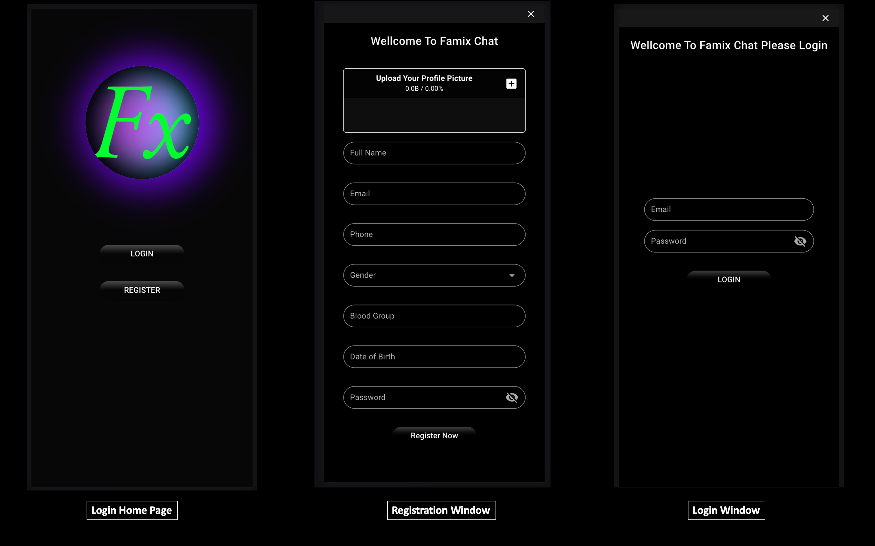

Slide 14
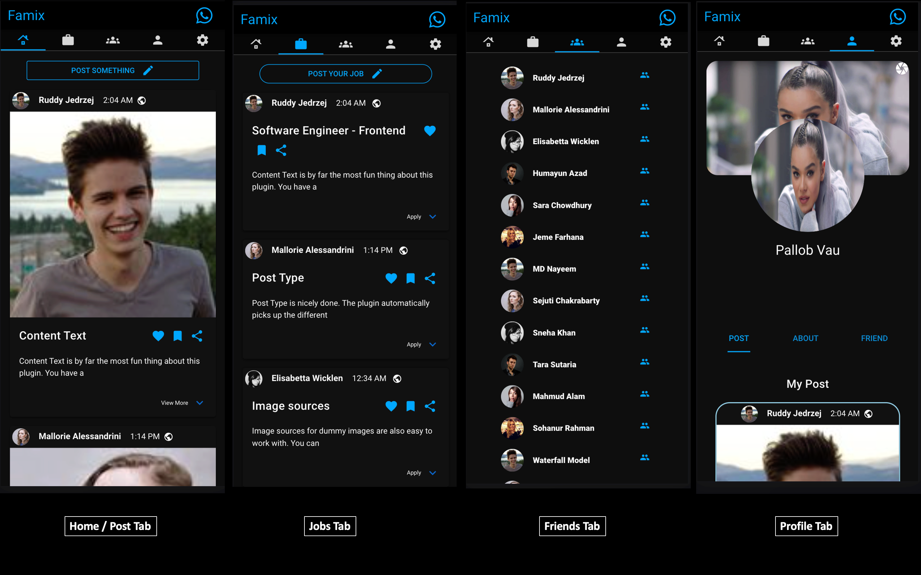

Slide 15
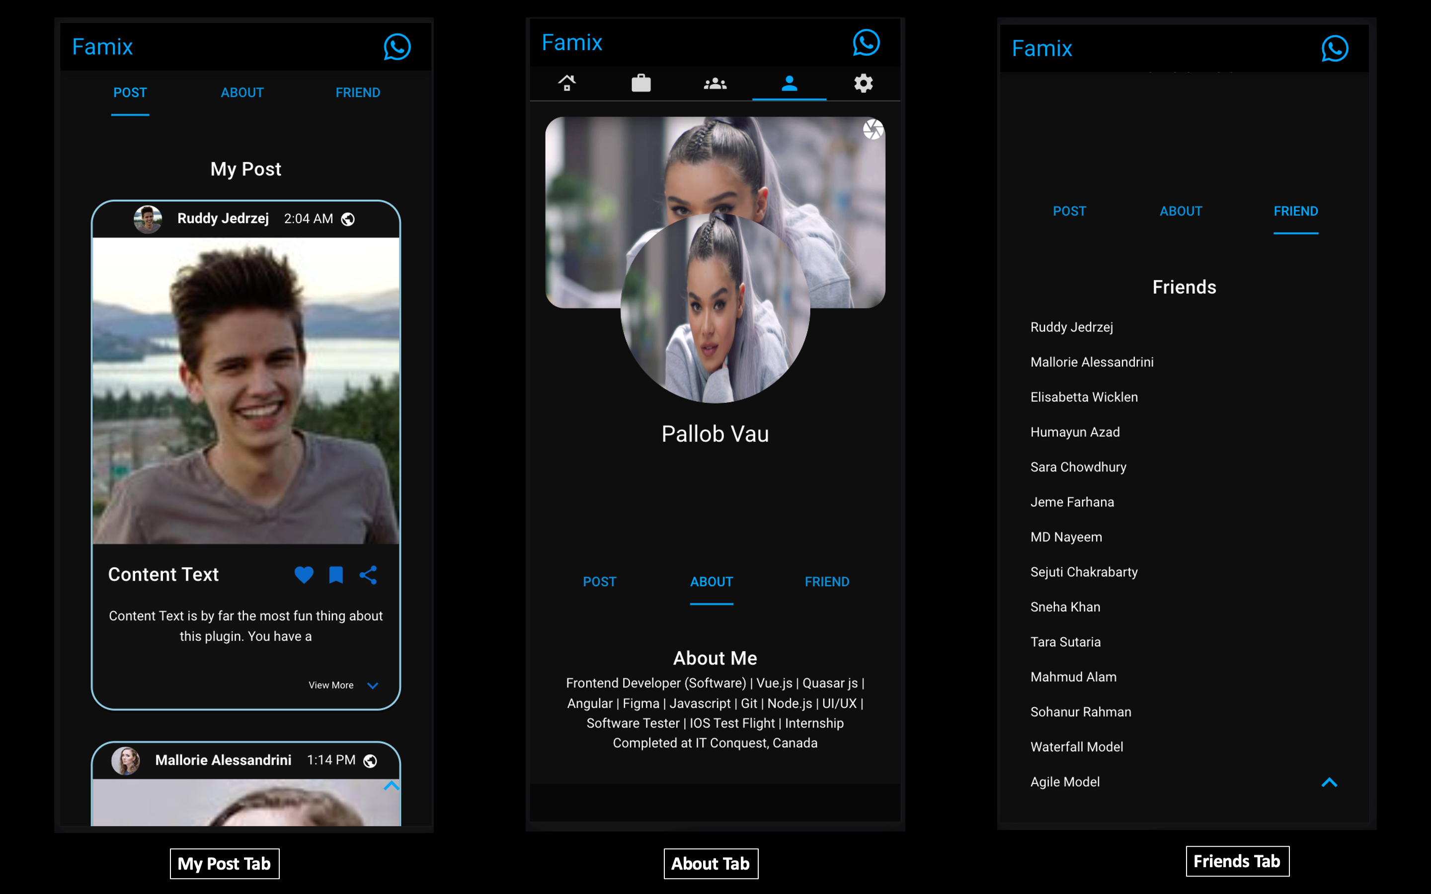

Slide 16
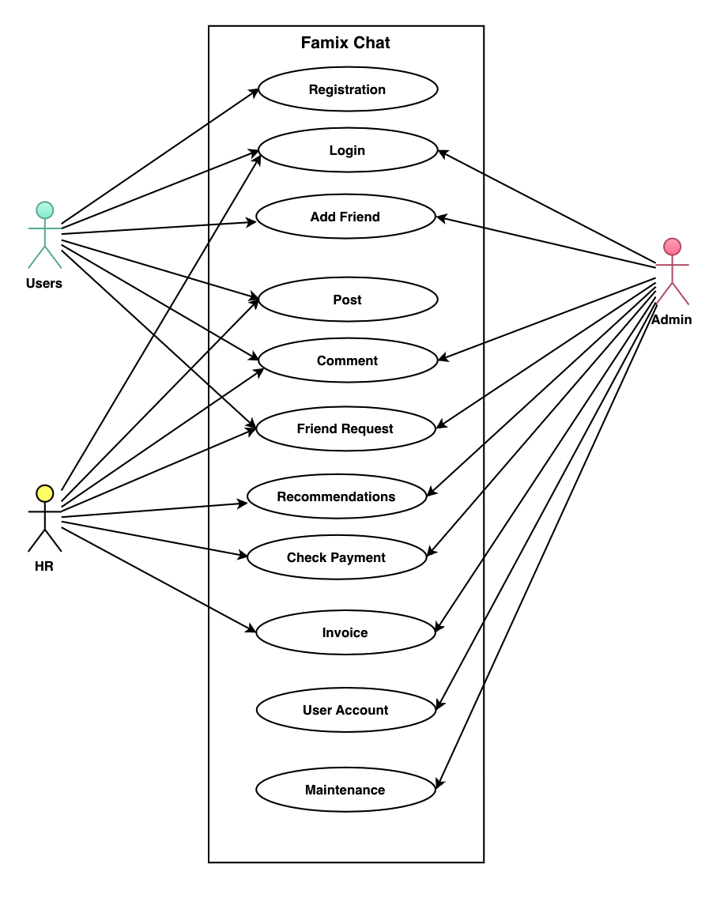
Use Case Diagram

Slide 17
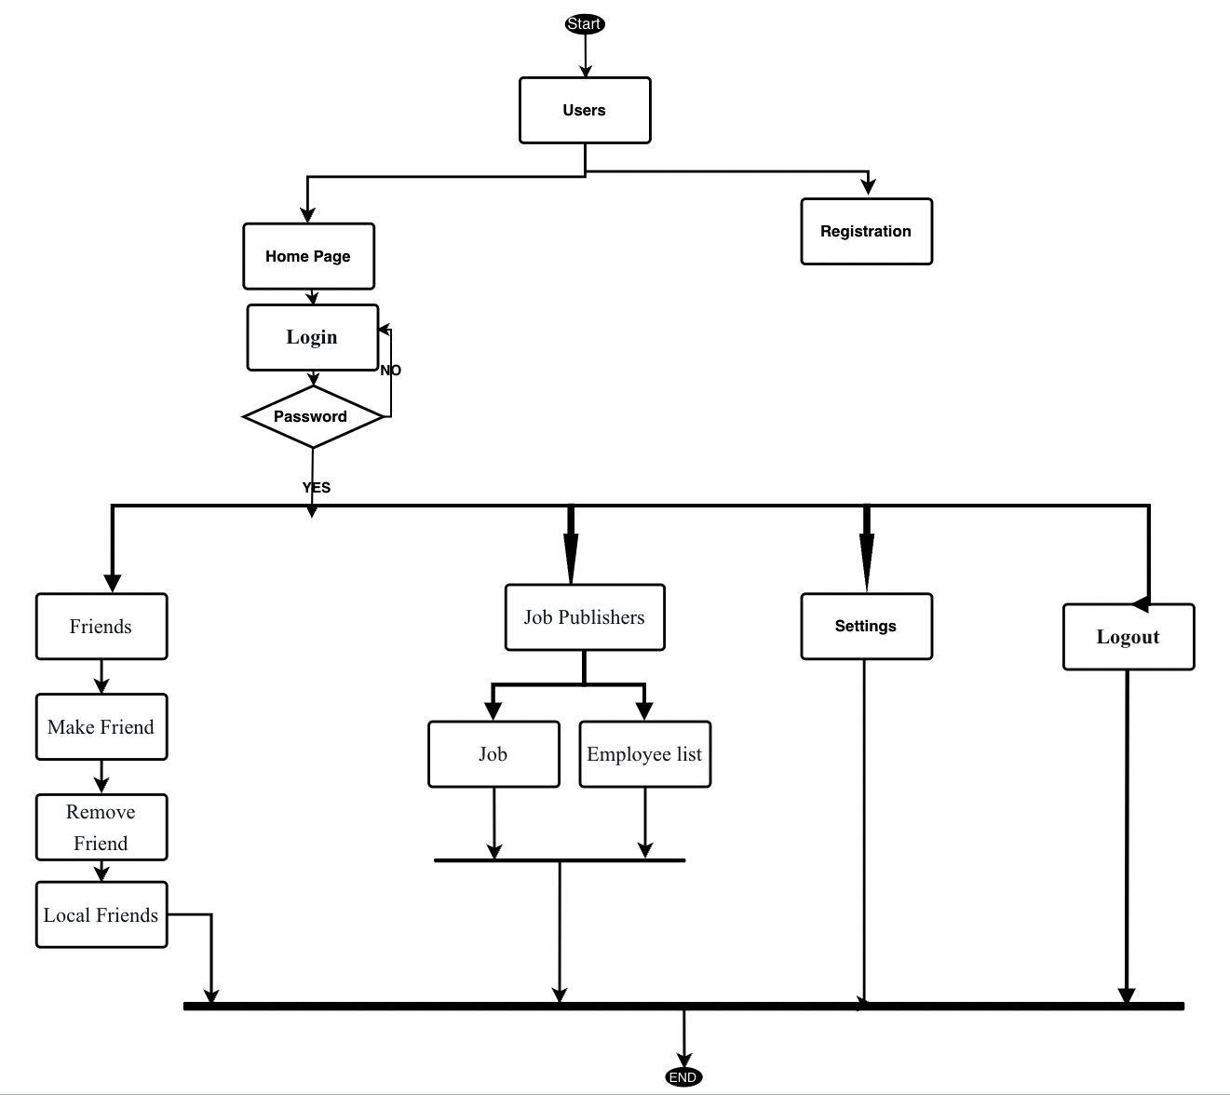
Data Flow Diagram

Slide 18
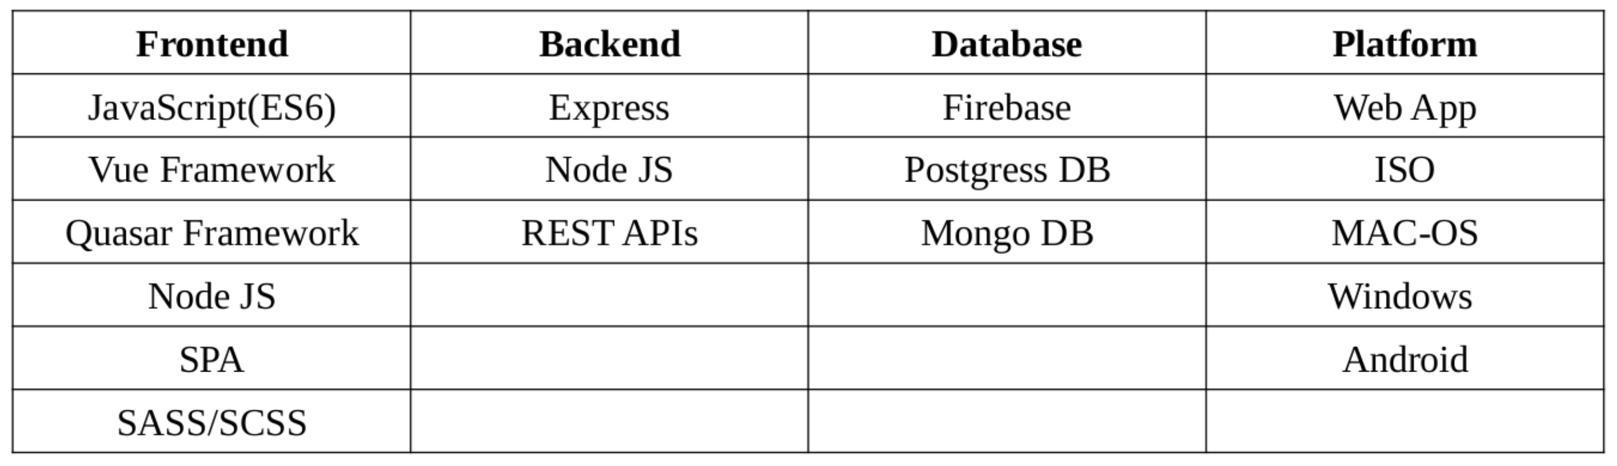
Tools

Slide 19


Gantt Chart
FEB
14
FEB
20
MAR
24
APR
7
MAY
8
JUN
5
JUL
6
AUG
7
SEP
1
OCT
9
DEC
10
MAR
1
Proposal finalization
Related work study
Project analysis
Features finalization
UI Design
Frontend
Backend
API Integrations
Deployment

Slide 20
Limitation
Our software’s limitations:
Minimal user interface
No data recodes
No Ads facilities

Slide 21
Testing
Testing Techniques | Activities
Functionality Testing | test user interface, APIs, database testing, security testing, client and server testing and basic software functionalities
2. Usability testing | Test the site Navigation, Test the Content
3. Interface Testing | Application, Web and Database Server
4. Database Testing | Test if any errors, Data Integrity is maintained while creating, updating or deleting data, Check response time of queries
5. Compatibility testing | Test if our web application is being displayed correctly across browsers, JavaScript and authentication is working fine
6. Performance Testing | response times at different connection speeds, Load test , Stress test, Test if a crash occurs due to peak load
7. Security testing | Test unauthorized access, Restricted files should not be downloadable

Slide 22
References
[1] S. Biswas, “Full Codebase in Github,” June 22, 2022, 02:30 AM. [Online]. Available:
https://github.com/ShuvobrotoBiswas/famix.
[2] Facebook, “All Concept,” [Online]. Available: https://www.facebook.com/settings, July
02, 2022, 08:30 AM.
[3] Make Apps with Danny, “Video Concept” [Online video]. Available:
https://www.youtube.com/watch?v=VMskuNmQBqE, August 20, 2022, 01:20 AM.
[4] J. Wallen, “End to End encrypted data on Facebook” [Online]. Available:
https://www.techrepublic.com/article/how-to-enable-end-to-end-encryption-in-facebook-messenger/,
February 9, 2022, 7:07 AM PST.
[5] Facebook, “Privacy” [Online]. Available: https://www.news18.com/news/tech/facebook-
rolls-out-end-to-end-encryption-on-messenger-voice-and-video-calls-4084049.html, August 14,
2021, 12:28 IST.

Slide 23
Thank You

